Slide 1
A Comparative Analysis of HAN, SVM and XGBoost for Fake News Detection
Aditya Agrawal 2022A7PS0160P
Shikhar Singh 2022A7PS1170P

Slide 2
The Problem: Fake News
Fake news proliferation across digital platforms represents a significant threat to social stability and public trust.
There is an urgent need for robust automated detection systems capable of identifying fabricated content.
PROBLEM STATEMENT:
Given a news article, determine whether it’s Legitimate or Fake.

Slide 3
Dataset
We utilized the WELFake dataset, which contains 72,134 news articles in total.
The dataset presents a balanced distribution of news articles:
35,028 articles labeled as real news (class 1)
37,106 articles labeled as fake news (class 0)
This balanced distribution is advantageous as it prevents class imbalance issues.
For experimental purposes, the dataset was split using a 80/20 train-test ratio.

Slide 4
FastText Embeddings
We used two distinct FastText embedding approaches for our news classification model:
Custom-trained FastText Model: Trained directly on the WELFake training dataset, allowing the embeddings to capture domain-specific language patterns and terminology present in news articles.
Pre-trained FastText Embeddings: Utilization of the publicly available cc.en.300.bin model, which contains 300-dimensional word vectors trained on Common Crawl and Wikipedia data, providing broad language coverage.
FastText was specifically chosen for its ability to handle out-of-vocabulary words.
This capability makes FastText particularly effective for news text analysis, which frequently contains:
Newly coined terms
Named entities
Other words not encountered during training

Slide 5
Models Implemented
Support Vector Machine
XGBoost
Hierarchical Attention Network (HAN)

Slide 6
Support Vector Machine
We implemented a Support Vector Machine (SVM) classifier using scikit-learn's LinearSVC for our fake news detection model:
The SVM configuration is specifically optimized for processing the high-dimensional FastText embeddings generated from textual data.
LinearSVC is wrapped with CalibratedClassifierCV to enable probability outputs, as standard SVMs only provide distance measurements from the decision boundary.
The model directly processes sentence embeddings generated by the FastText model:
These embeddings capture semantic information from both the title and text fields of news articles.
This approach leverages SVM's effectiveness in high-dimensional spaces:
The classifier identifies optimal hyperplanes that separate document categories based on their vector representations.

Slide 7
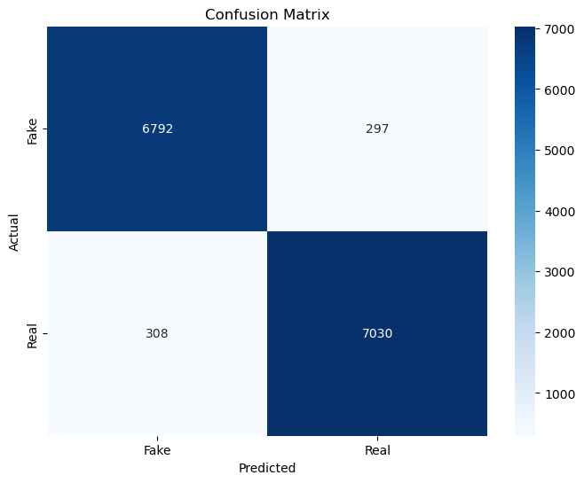
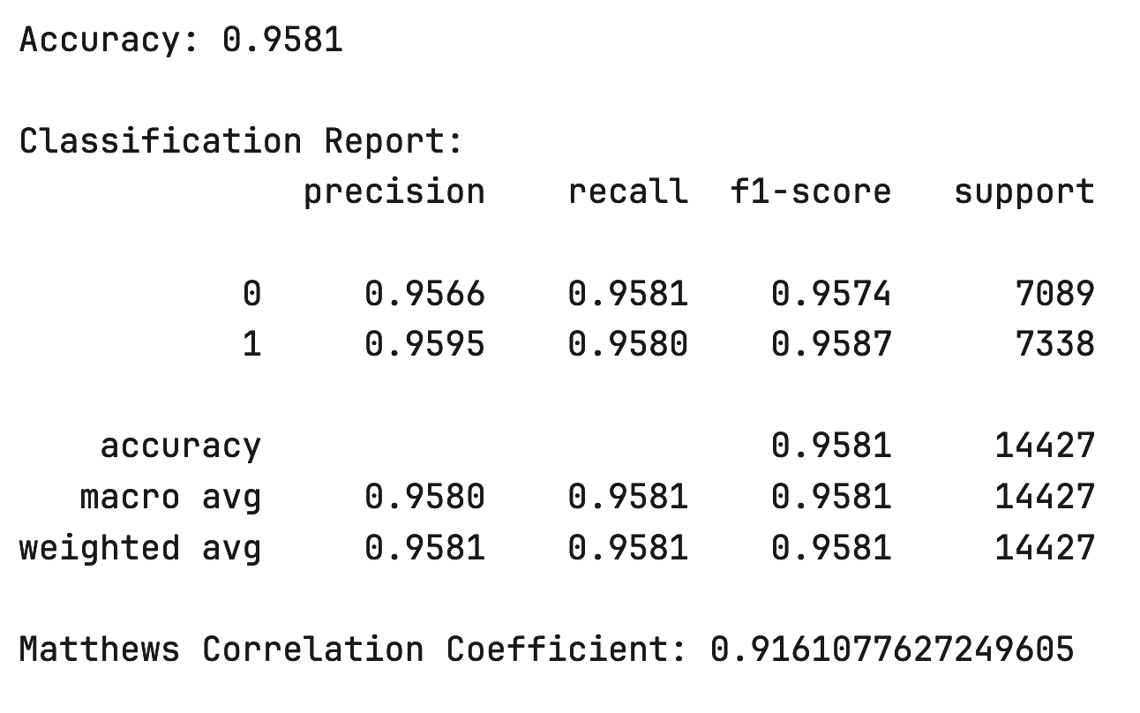
SVM: Metrics

Slide 8
2. XGBoost
We implemented XGBoost, a powerful gradient boosting framework, as our second classification approach:
The model utilizes XGBClassifier with carefully tuned hyperparameters:
100 gradient-boosted decision trees
Moderate learning rate of 0.1
Tree depth limited to 5 levels to prevent overfitting
subsample parameter set to 0.8 (randomly selects 80% of training instances per tree)
colsample_bytree parameter set to 0.8 (randomly selects 80% of features per tree)
Binary logistic objective function, appropriate for fake/real news classification
Early stopping mechanism after 10 rounds without improvement for training efficiency
The model processes the same FastText-generated document embeddings used in the SVM approach.

Slide 9

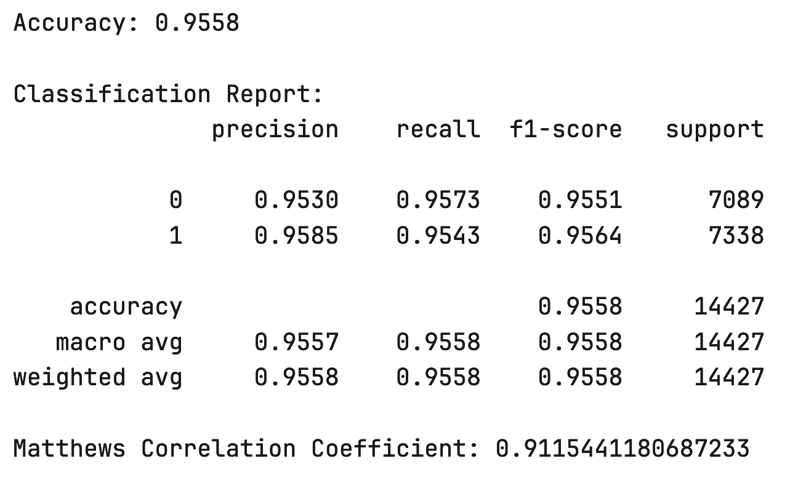
2. XGBoost: Metrics

Slide 10
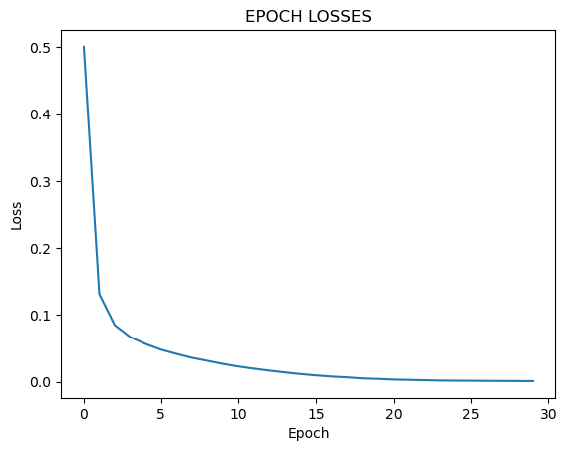
3. Hierarchical Attention Network (HAN)
We implemented a Hierarchical Attention Network (HAN) with the following architecture:
An embedding layer followed by Bidirectional GRUs and Attention modules operating at both word and sentence levels
Embedding layer output size: 200
Hidden layer size (for GRU output): 50
Preprocessing specifically for the HAN architecture:
Text was tokenized using the PUNKT tokenizer from NLTK, which generated a 3D tensor with dimensions: (num_examples, num_sentences=20, num_words=20)
The training configuration utilized the following parameters:
Optimizer: Adadelta with learning rate of 0.03
Loss function: Binary cross entropy
Training duration: 30 epochs

Slide 11

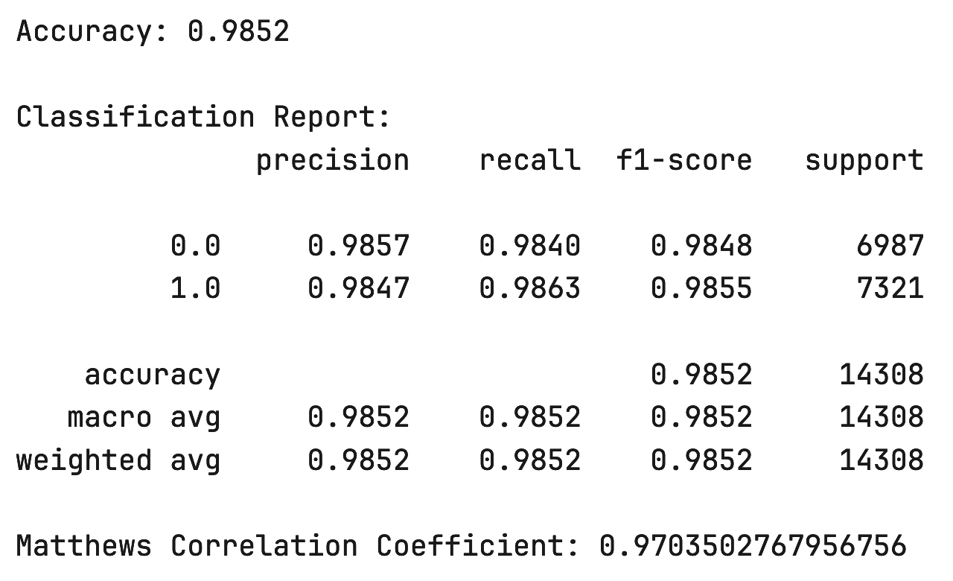
3. HAN: Metrics

Slide 12
Results
Model | Accuracy | Precision | Recall | F1-Score | MCC
SVM | 0.9581 | 0.9581 | 0.9581 | 0.9581 | 0.9161
XGBoost | 0.9558 | 0.9558 | 0.9558 | 0.9558 | 0.9115
HAN | 0.9852 | 0.9852 | 0.9852 | 0.9852 | 0.9703

Slide 13
Conclusion
The confusion matrices clearly demonstrated HAN's exceptional classification capabilities compared to the other models.
HAN's substantial performance advantage highlights its ability to effectively capture semantic nuances and contextual relationships within news articles.
Despite the strong performance of both SVM and XGBoost, the clear superiority of the HAN model suggests deep learning approaches with attention mechanisms are particularly well-suited for fake news detection.
The hierarchical structure of HAN may provides a significant advantage in understanding both word-level and sentence-level features in news text.

Slide 14
THANK YOU

